Slide 1
Rajeshreddy Desham Studentid:1682826
PROJECT Big Data Analytics with Hadoop and R

Slide 2
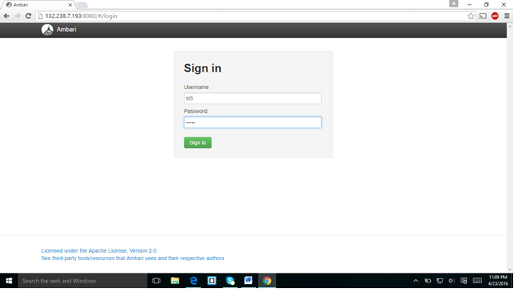
Project Hive

Slide 3
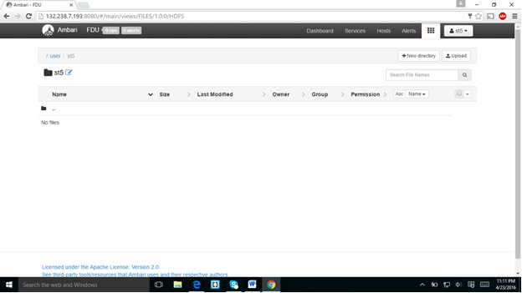
Navigating into my folder

Slide 4
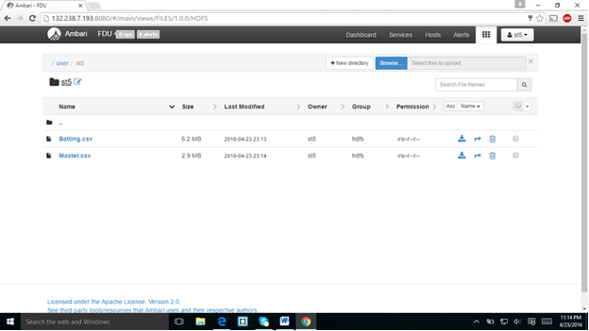
This is my folder and I downloaded the Batting.csv and master.csv.and showed in the below screenshot.

Slide 5
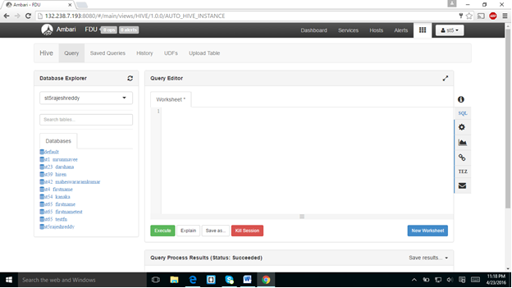
I created the database in my name and selected my database with my name.

Slide 6
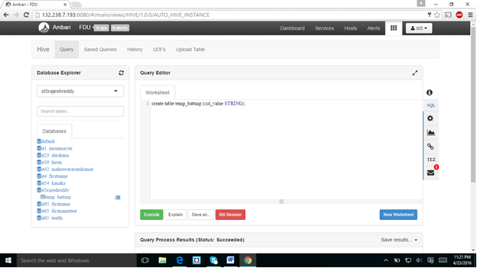
I created the table temp_batting with column (col_value).

Slide 7
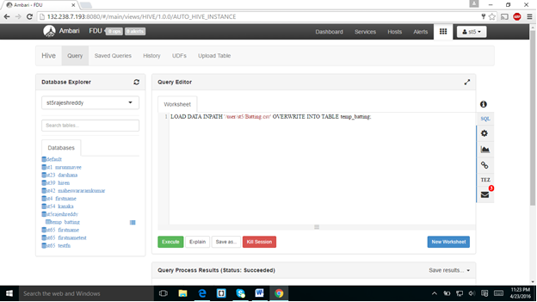
I loaded DATA from batting.csv into temp_batting.And I displayed the table .

Slide 8
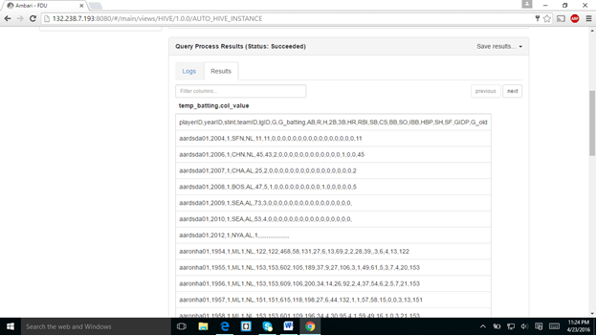
16)ANSWER: Only one column is in table temp_batting.

Slide 9
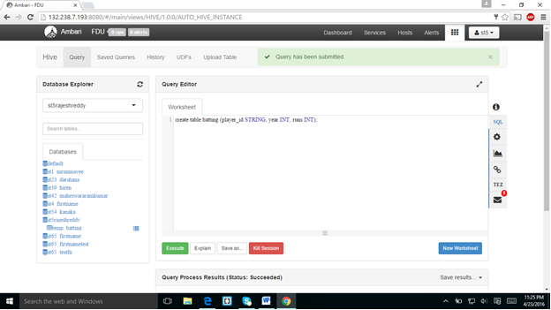
In the next screen shot I created the table batting with columns player_id ,year and runs.

Slide 10
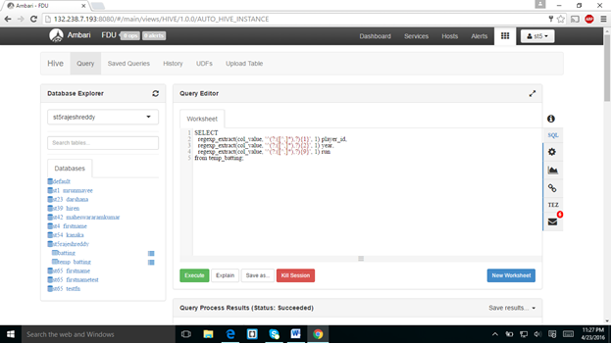
From table tempbatting I inserted data to other columns.and populated in down screenshot.

Slide 11
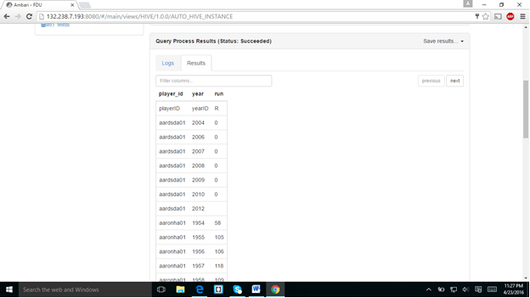

Slide 12
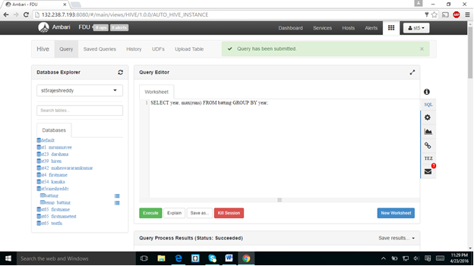
The above query is about maximum runs from batting group by year which was displayed in below screen shot.

Slide 13
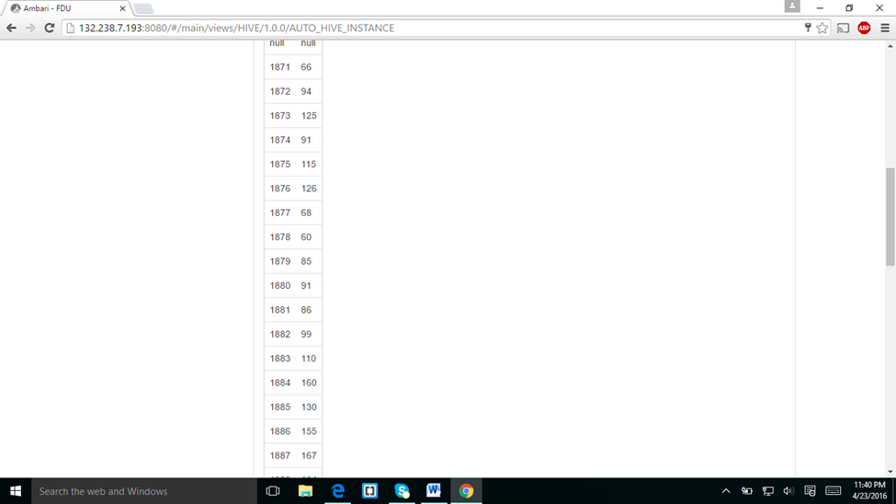

Slide 14
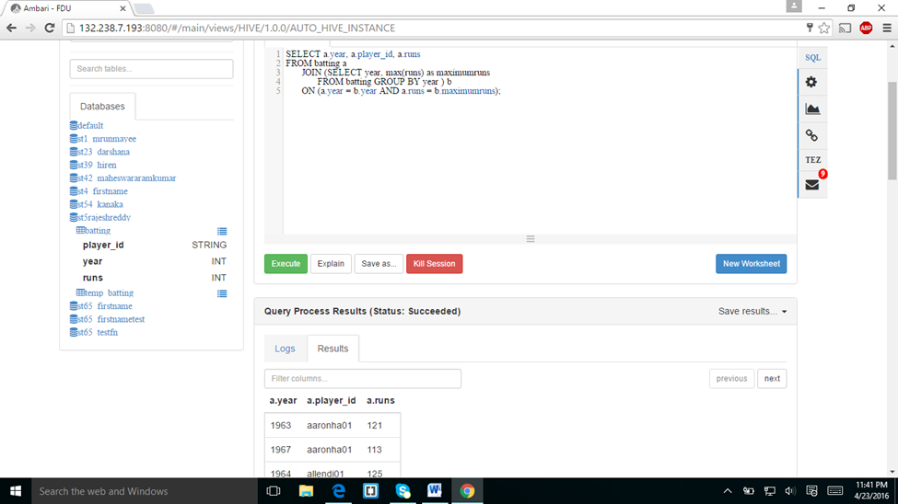
I created the join statement and results were displayed below.
24 ANSWER: 1963-aaronha01-121

Slide 15
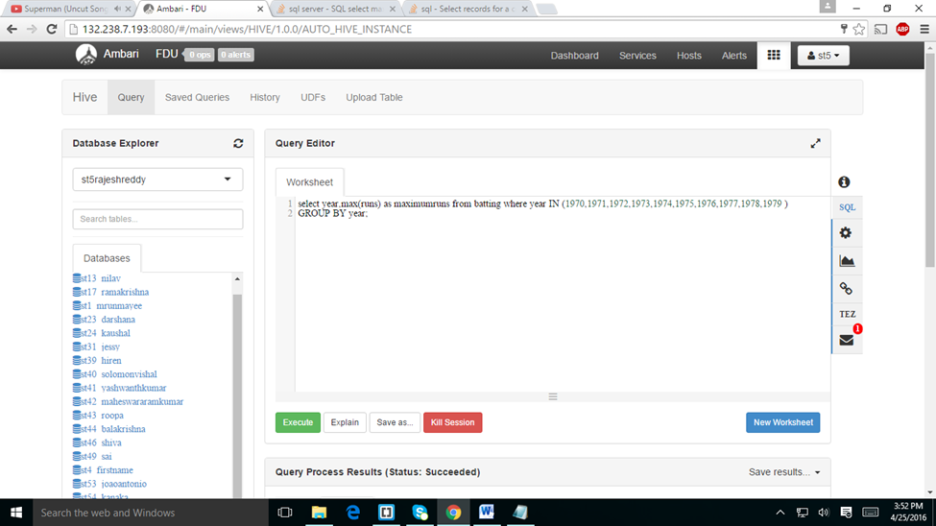
ASSIGNMENT-2

Slide 16
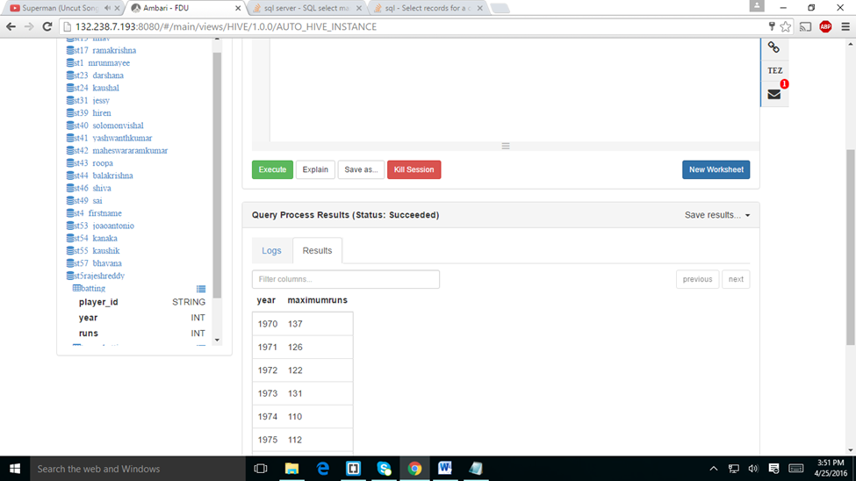

Slide 17
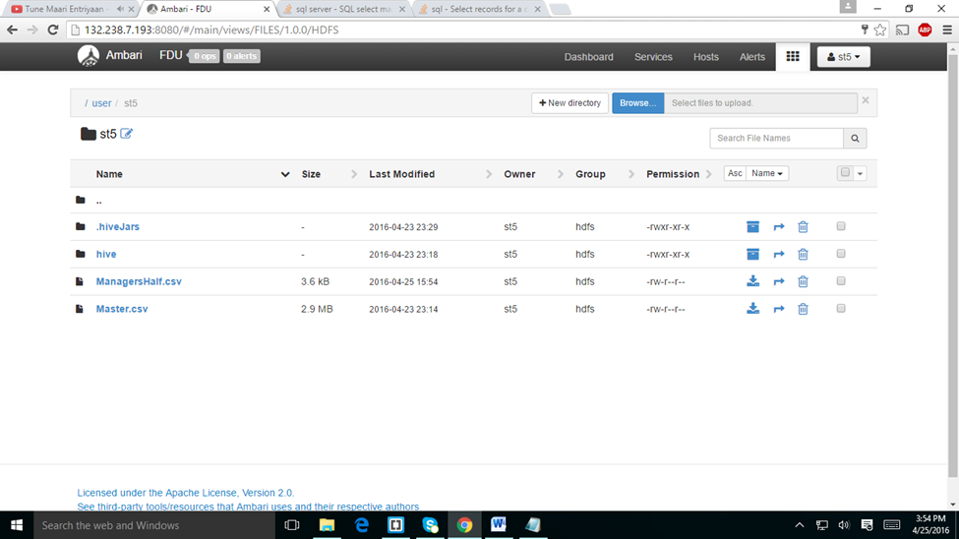
ASSIGNMENT-3

Slide 18
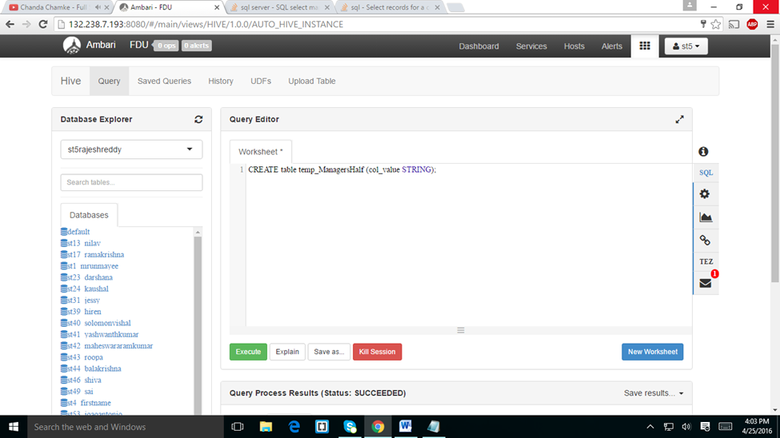

Slide 19
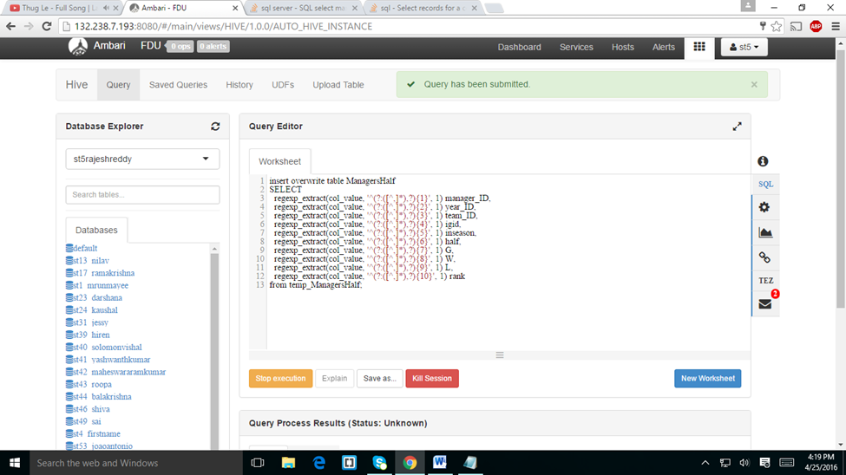

Slide 20
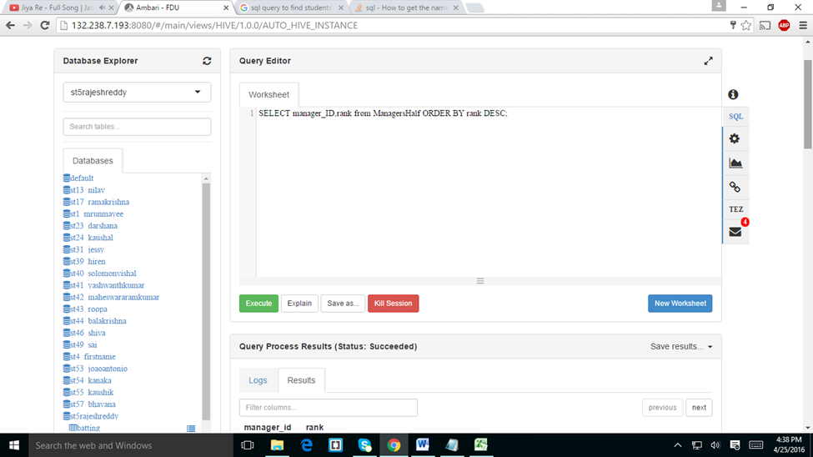

Slide 21
